Slide 1
HTML FORMS

Slide 2
Forms
Forms are used to create interactive websites.
Forms are used to collect data form the users.
Forms are an easier way for the user to communicate with the webmaster or the owner of the website.
• Forms can be used for different purposes:
Educational sites.
Research sites.
Online orders/Online banking.
Feedback.

Slide 3
Forms
A form consists of different types of elements. Each type of element is used for different purpose.
Some important form elements are as follows:
Textbox.
Listbox.
Radio Button.
Checkbox.
Text Area.
Password Field.

Slide 4
<FORM> Tag
<FORM> tag is used to create a form in a web page.
All form elements are inserted within <FORM> and </FORM> tags.
A web page may contain many forms.
Example:
<FORM NAME=“datafrm” METHOD =“Post” ACTION =“data.asp”>

Slide 5
<FORM> Tag
Attributes:
NAME : Specifies the name of the form.
METHOD : Specifies how the form data is sent to the server.
GET : sends data as part of URL. It is default value.
POST : Sends data as part of HTTP request. It is used for large amount of data.
ACTION : Specifies the page to be invoked on the server as a result of the form data submission. It is normally a script file (page) on the server.

Slide 6
Form Elements
Form elements are inserted using <INPUT> tag.
The TYPE attribute of <INPUT> tag specifies the type of form element to be inserted in the form.
General syntax of <INPUT> tag is:
<INPUT TYPE =“Form_Element_Name”>

Slide 7
Text Box/Text Field
Text boxes/Text fields are used to get input from the user in the form of letters, number etc.
To insert text box in a form; TYPE attribute value in the <INPUT> tag should be set to “Text”.
Common attributes of text box, that can be used inside <INPUT> tag are:
NAME : Specifies the name of the text box.
VALUE : Specifies the default value to be present in the text boxes.
MAXLENGTH : Specifies the maximum number of characters that can be entered in the text box.

Slide 8
Password Field
Password field is used to input password in the form.
Each character inserted in this field appears in a symbol .i.e. * etc.
To insert password field in a form; TYPE attribute value in the <INPUT> tag should be set to “Password”.
The attributes of password field are the same as of text field.
Example :
<INPUT TYPE =“Password” NAME =“pass”>

Slide 9
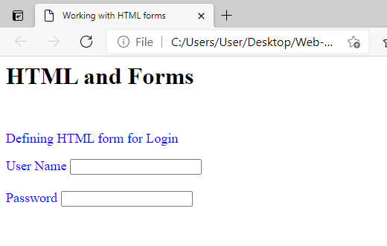
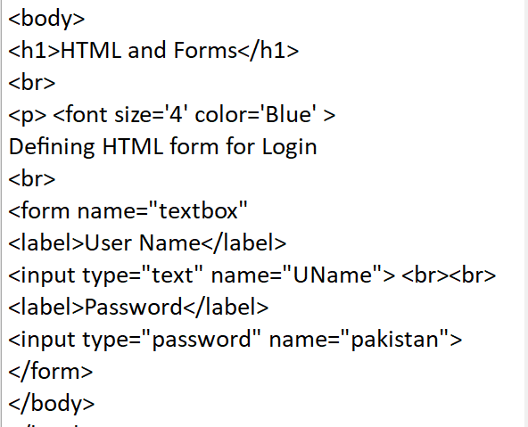
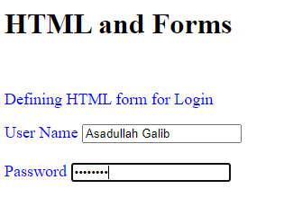
Example

Slide 10
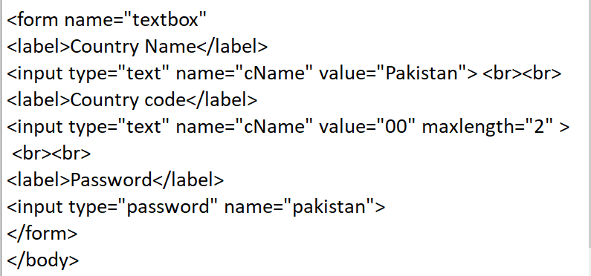
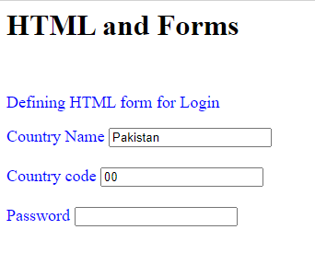
Example with default values

Slide 11
Radio Button
Radio buttons are used when the user has to choose one option from multiple choices.
To insert radio button in a form; TYPE attribute value in the <INPUT> tag should be set to “Radio”.
<INPUT TYPE=“radio”>

Slide 12
Radio Button Attributes
NAME : Specifies the name of the radio button.
If the name is same for all of the radio buttons, they makes the group. The user can select one radio button from the group.
If the names are different, the user can select all of the radio button at the same time.
VALUE : Refers to the value attached with the radio button.
CHECKED : Specifies that the radio button is selected by default.
Examples:
<INPUT TYPE=“radio” NAME=“religion” VALUE=“Islam”>

Slide 13
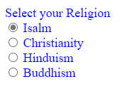
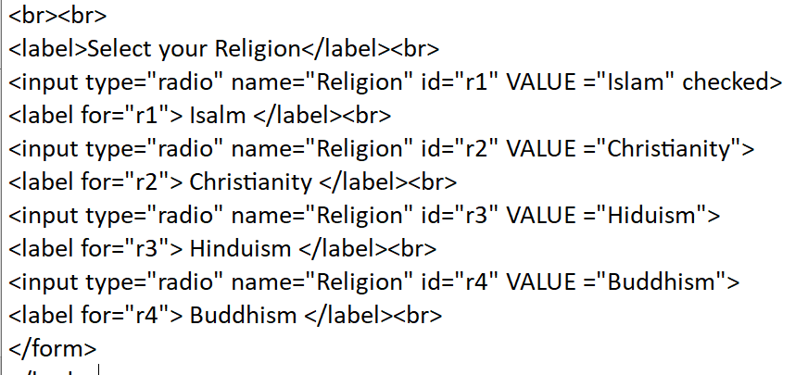
Grouped Radio Button

Slide 14
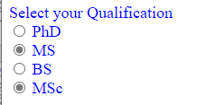
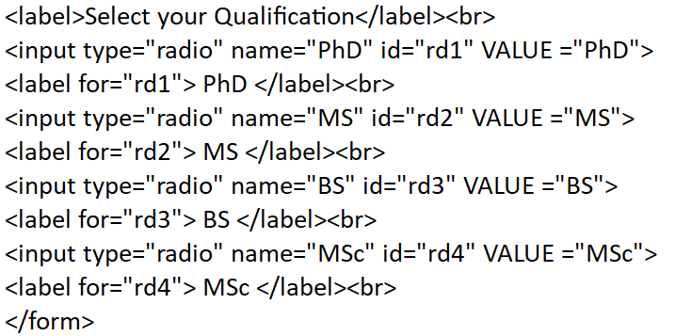
Ungrouped Radio Button

Slide 15
Checkboxes
Like radio buttons, checkboxes can also be used to select options.
The user can choose one or multiple options from the available choices.
Checkboxes cannot be grouped, even if the name is the same.
To insert checkbox in a form; TYPE attribute value in the <INPUT> tag should be set to “Checkbox”.
The attributes of checkboxes are the same as radio buttons.
Examples:
<INPUT TYPE=“Checkbox” NAME=“gender” VALUE=“MALE”>

Slide 16
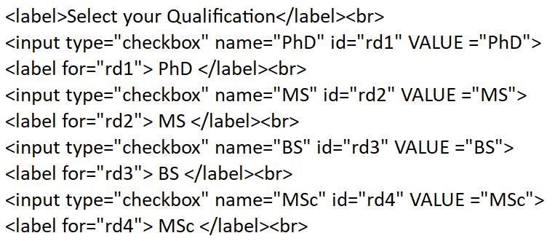
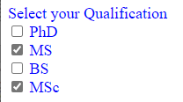
Checkbox

Slide 17
Combolist or Select Field
Combolist is used to provide predefined list of items to the user.
The user can choose one or multiple options from the list depending upon the type of list.
<SELECT> tag is used to create a list.
<OPTION> tag is used to create an item in the list.
All of the <OPTION> tags must be enclosed in <SELECT>--- </SELECT>

Slide 18
Combolist or Select Field Attributes
NAME : Specifies the name of the combolist.
MULTIPLE : Specifies that multiple items can be selected from a list at the same time by clicking CTRL key.
SIZE : Specifies that how many items to be displayed at a time.
Default is one.
Attributes used in <OPTION> tag.
VALUE : Specifies the value of a list item.
SELECTED : Specifies that the current item in the list is selected.

Slide 19
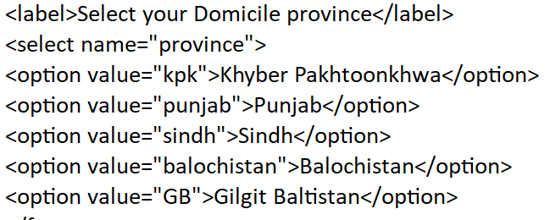

Example

Slide 20
Text Area
Text area is similar to text box but it may consists of multiple rows.
It is used to get lengthy input from the user like comments and suggestions etc.
Tags used to create text area in a form.
<TEXTAREA>---</TEXTAREA>

Slide 21
Text Area Attributes
NAME : Specifies name of the text area.
VALUE : Specifies the contents of the text area.
ROWS : Specifies number of rows in the text area.
COLS : Specifies number of columns in the text area.
• Example:
<TEXTAREA NAME =“text” COLS=“20” ROWS=“30”>
Default text
</TEXTAREA>

Slide 22
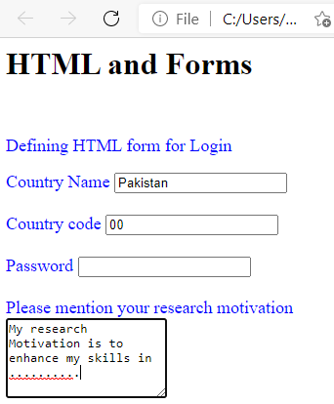
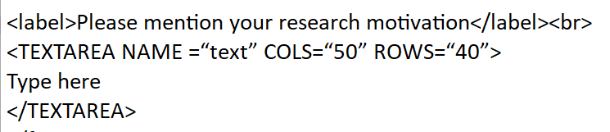
Text Area

Slide 23
File Upload Field
File upload filed is used to specify the path of a file on the user disk.
The user can select a file from the disk using this field.
To insert file upload field in a form; TYPE attribute value in the <INPUT> tag should be set to “File”.
Attributes are:
NAME : Specifies the name of the button.
VALUE : Specifies the file name and path of the selected file.
• Example:
<input type="file" id="myfile" name="myfile">

Slide 24
Buttons
Buttons are used in forms to process the form data.
Types of buttons are:
Submit Button.
Reset Button.
Normal Button.
<INPUT TYPE=“button”>

Slide 25
Buttons
Submit Button.
It is a predefined button. When user clicks submit button, it sends the data in the form fields to the file specified in ACTION attribute of the <FORM> tag.
<INPUT TYPE=“Submit”>
Reset Button.
It is a predefined button. When the user clicks this button, it clears all the data entered by the user in different from elements.
<INPUT TYPE=“Reset”>
Normal Button.
This type of button is used by the user to associate a particular action with its clicking by using client side scripting.
<INPUT TYPE=“button”>

Slide 26
Buttons Attributes
NAME : Specifies the name of the button.
VALUE : Specifies the caption of the button.
<INPUT TYPE=“Submit” NAME=“Sumbitbtn” VALUE=“Submit”>

Slide 27
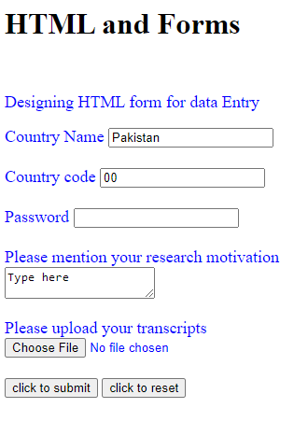
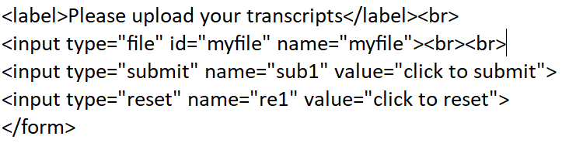
Example

Slide 28
Lab 4
Create an HTML form to place a shopping order. Use maximum elements and their attributes

